Slide 1
FOOD & DRINK

Slide 2
BASICS
Introduction

Slide 3
Breakfast – “desayuno”
A continental-style breakfast – “desayuno” may be taken just after waking up, or before entering the workplace. Due to the large time span between breakfast and lunch, it is not uncommon to halt the working schedule to take a mid-morning snack.

Slide 4
Lunch – “almuerzo”
Lunch (el almuerzo or simply la comida, literally meaning "the food"), the large midday meal in Spain, contains several courses. It usually starts between 2:00 pm or 2:30 pm finishing around 3:00 pm to 3:30 pm

Slide 5
Dinner – “cena”
La cena, meaning both dinner or supper, is taken between 8:30pm and 10pm. It is lighter than lunch, consisting of one course and dessert. Due to the large time span between lunch and dinner, an afternoon snack, la merienda, equivalent to afternoon tea, may take place at about 6pm.

Slide 6
Conjugation of ‘Comer’ - present indicative
Yo como
Tu comes
Usted come
El come
Ella come
Nosotros/as comemos
Vosotros comeis
Ustedes comen
Ellos/as hablan

Slide 7
BASICS
Words and images

Slide 8
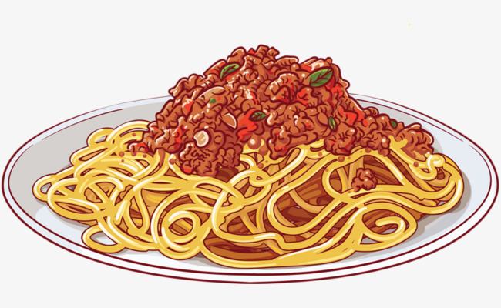
pasta – la pasta

Slide 9
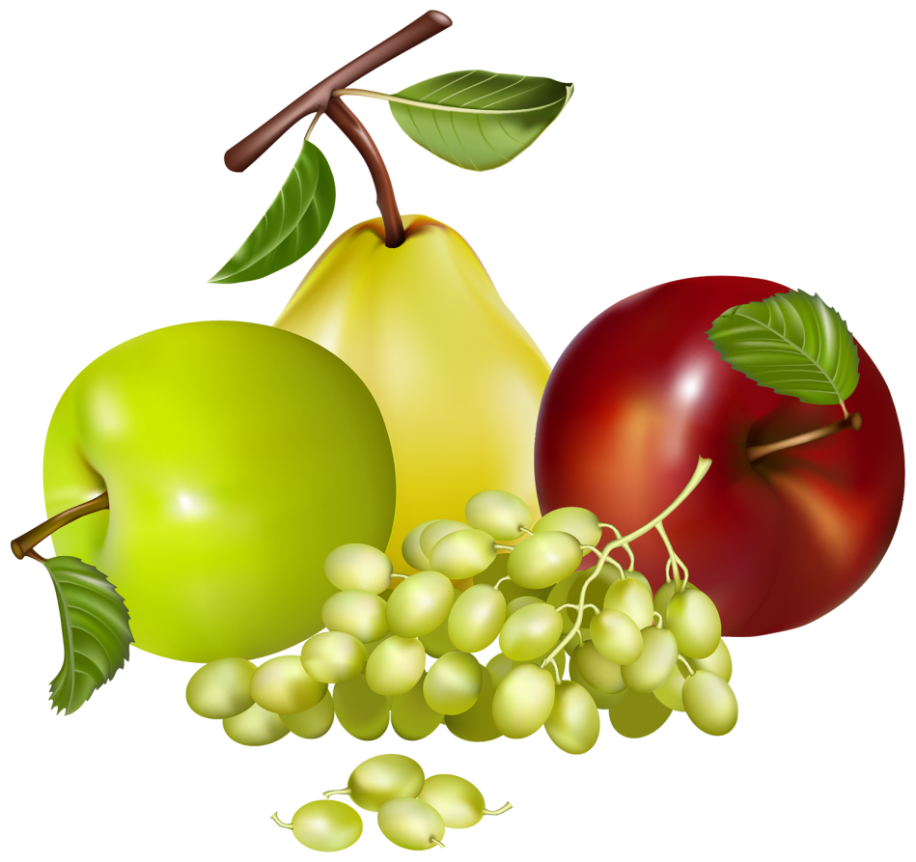
fruit – la fruta

Slide 10
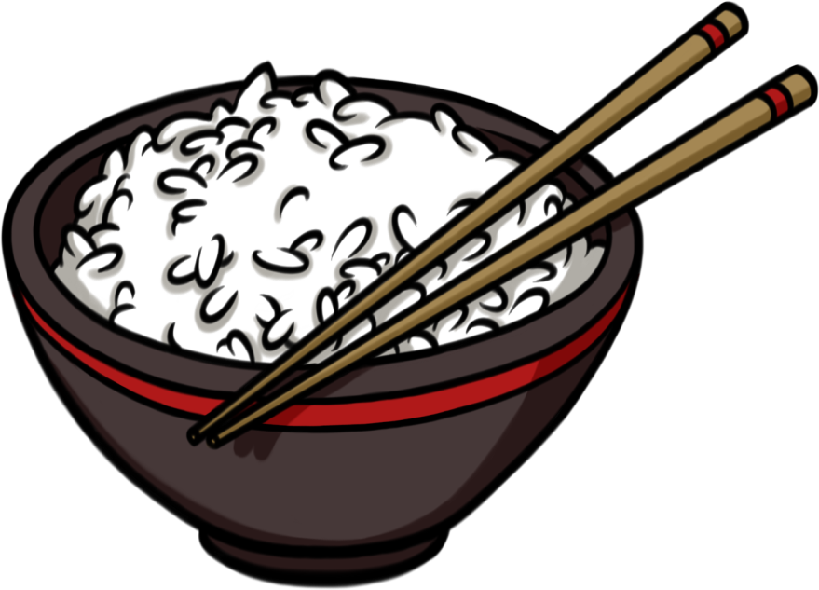
rice – el arroz

Slide 11
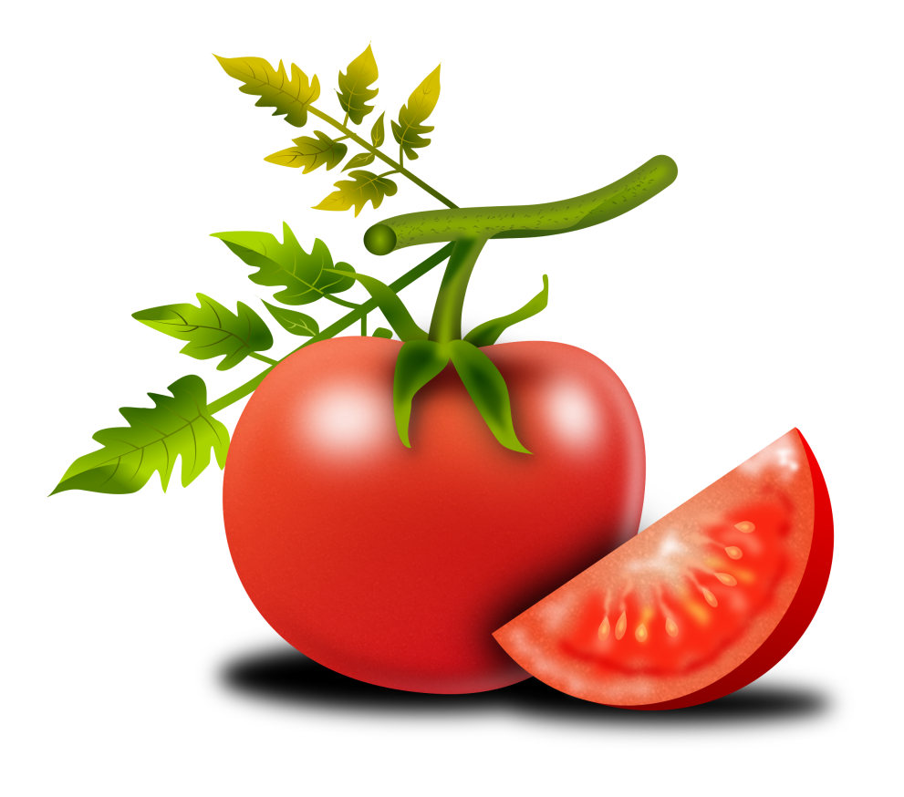
tomato – el tomate

Slide 12
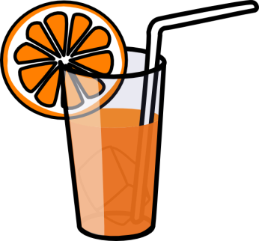
juice – el jugo

Slide 13
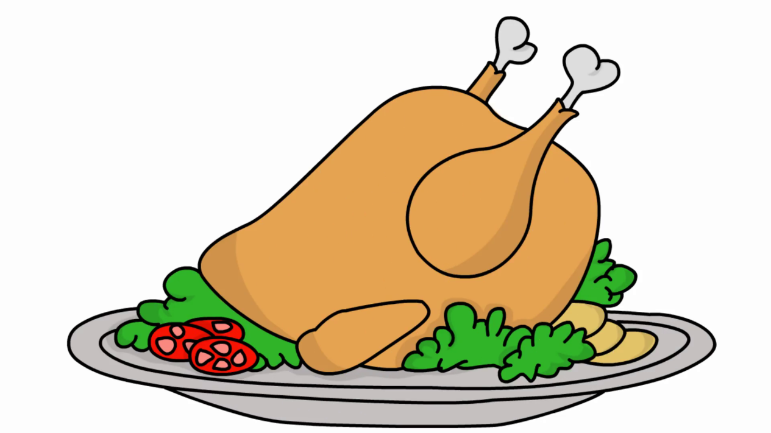
chicken – el pollo

Slide 14
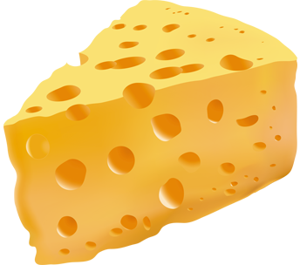
cheese – el queso

Slide 15
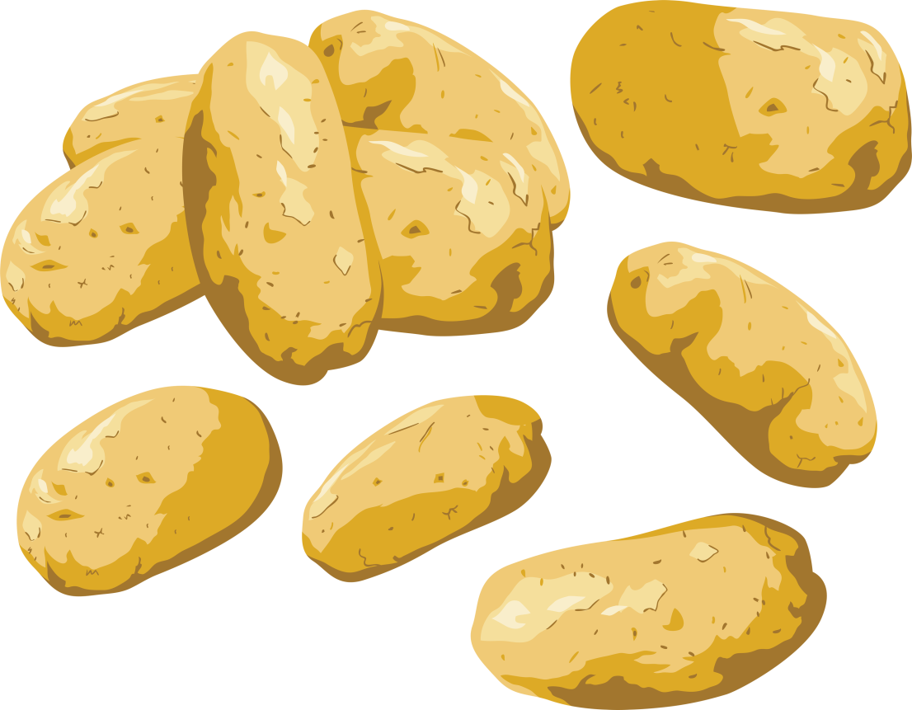
potato – la pata

Slide 16

fish – el pescado

Slide 17
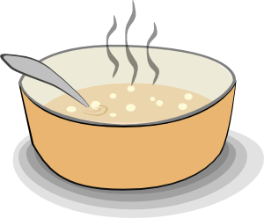
soup – la sopa

Slide 18
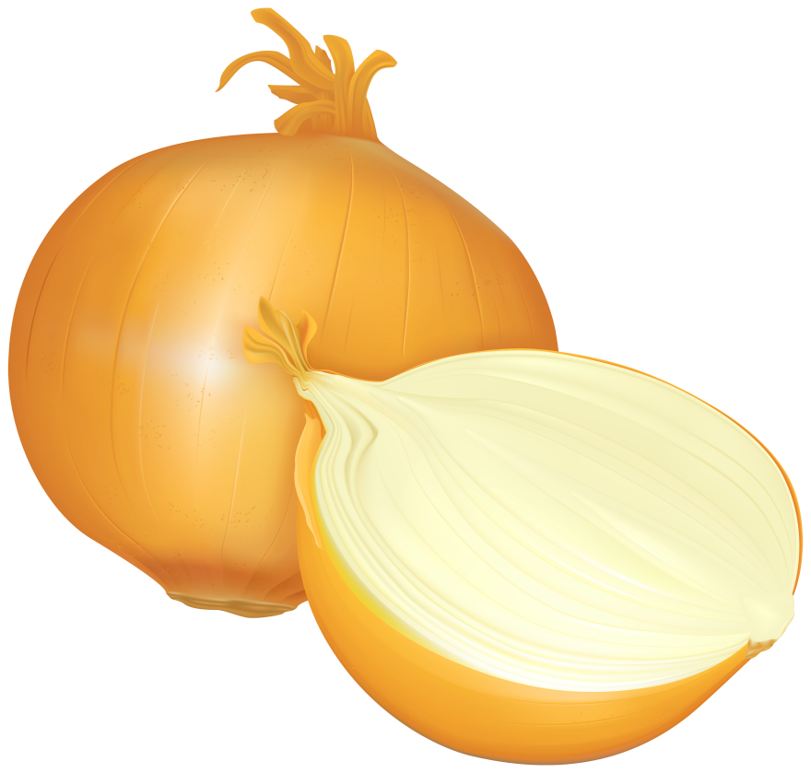
onon – la cebolla

Slide 19
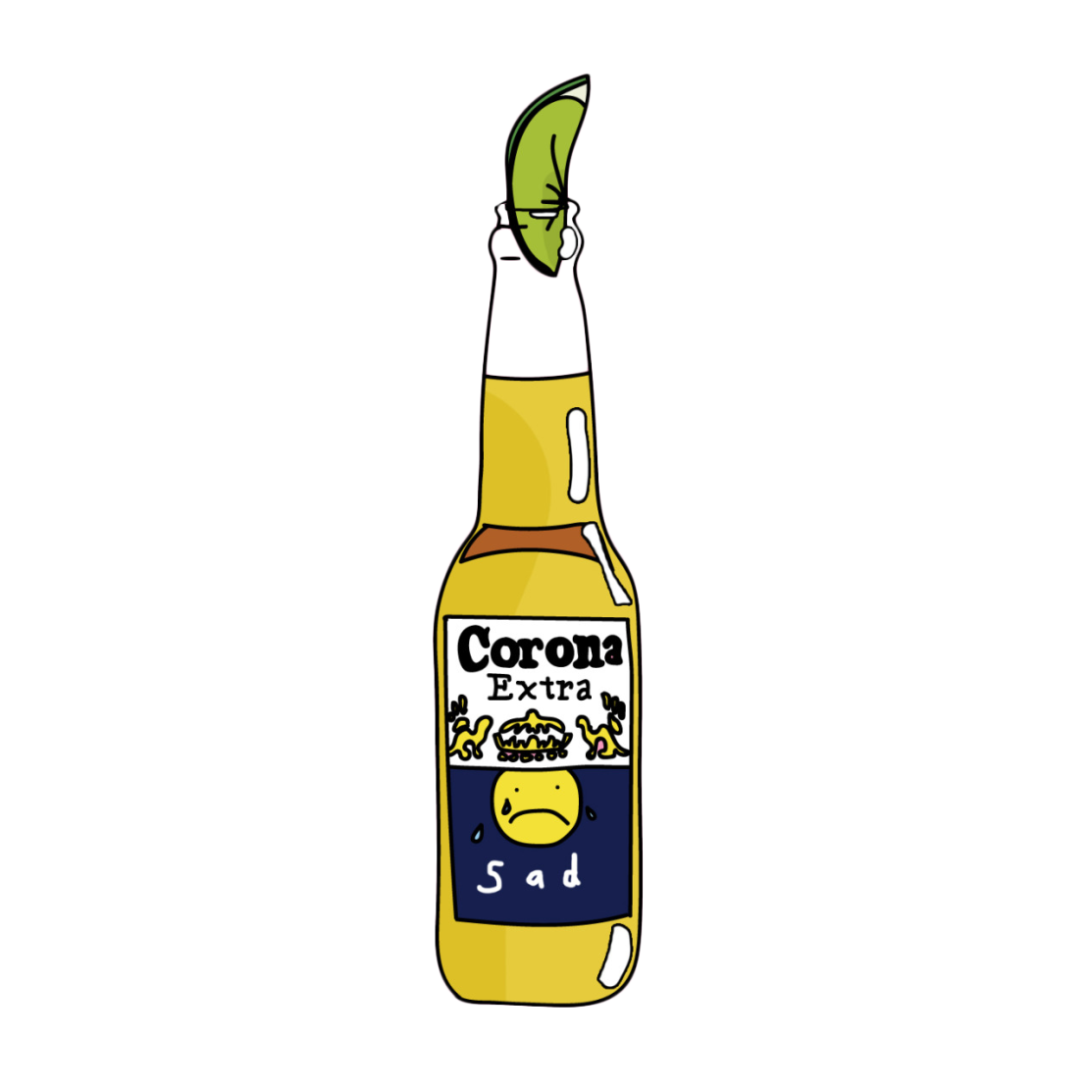
beer – la cerveza

Slide 20

tea – el té

Slide 21

apple – la manzana

Slide 22
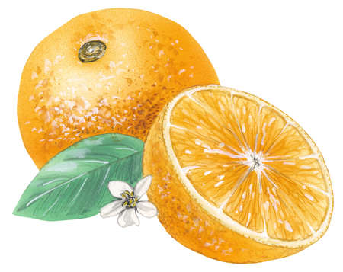
orange – la naranja

Slide 23
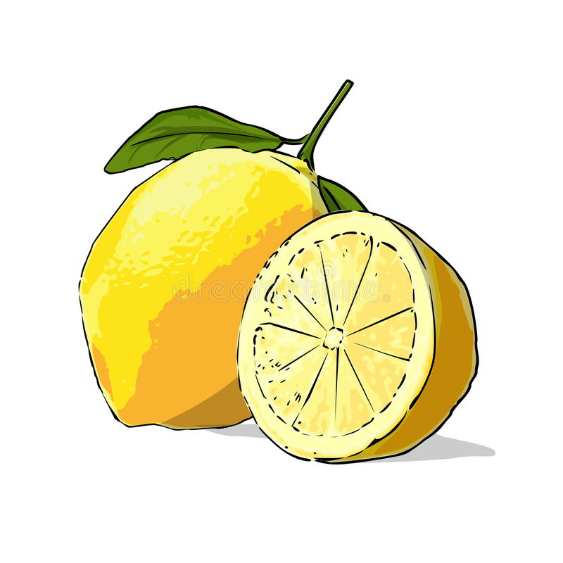
lemon – el limon

Slide 24
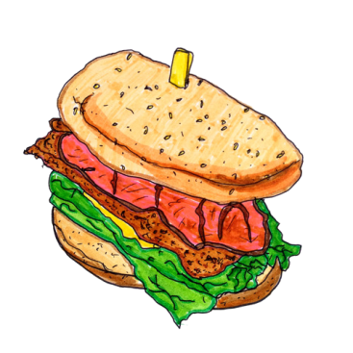
sandwich – el emparedado

Slide 25
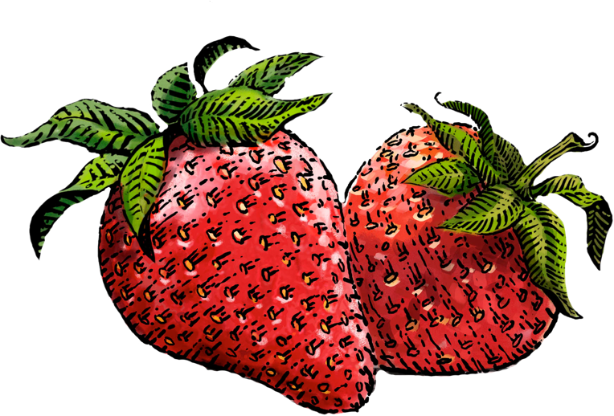
strawberry – la fresa

Slide 26

egg – el huevo

Slide 27
BASICS
Sentences

Slide 28
Sentences
Si, yo cocino. – Yes, I do cook.
Yo no como pasta. – I do not eat pasta.
Yo almuerzo fruta. – I eat fruit for lunch.
No, no es un tomate. – No, it is not a tomato.
Yo cocino carne. – I cook meat.
¿Es el jugo? – Is it the juice?

Slide 29
Sentences
No comemos manzanas. – We do not eat apples.
Tu comes queso. – You eat cheese.
El nino come pollo. – The boy eats chicken.
Como arroz. – I eat rice.
Ellas comen pescado. – They eat fish.
Usted no come sopa. – You do not eat soup.

Slide 30
Sentences
El huevo y el pollo. – The egg and the chicken.
La naranja y el limon. – The orange and the lemon.
Si, ellos comen fresas. – Yes, they eat strawberries.
Yo desayuno. – I eat breakfast.
Si, es una cena. – Yes, it is a dinner.
La papa y la cebolla. – The tomato and the onion.

Slide 31
Sentences
No soy vegetariana. – I am not vegetarian.
Es un menu. – It is a menu.
Un emparedado y un te. – A sandwich and a tea.
La nina bebe jugo. – The girl drinks juice.
Es la comida. – It is the food.
Es te, no es cerveza. – It is tea, not beer.

